Slide 1
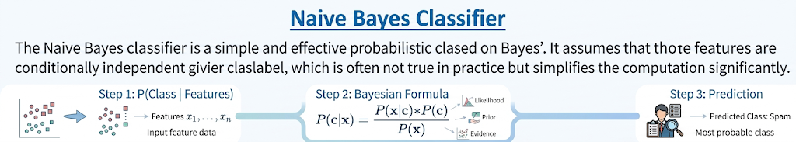
Supervise Learning Algorithm
Based on applying Bayes Theorem

Slide 2
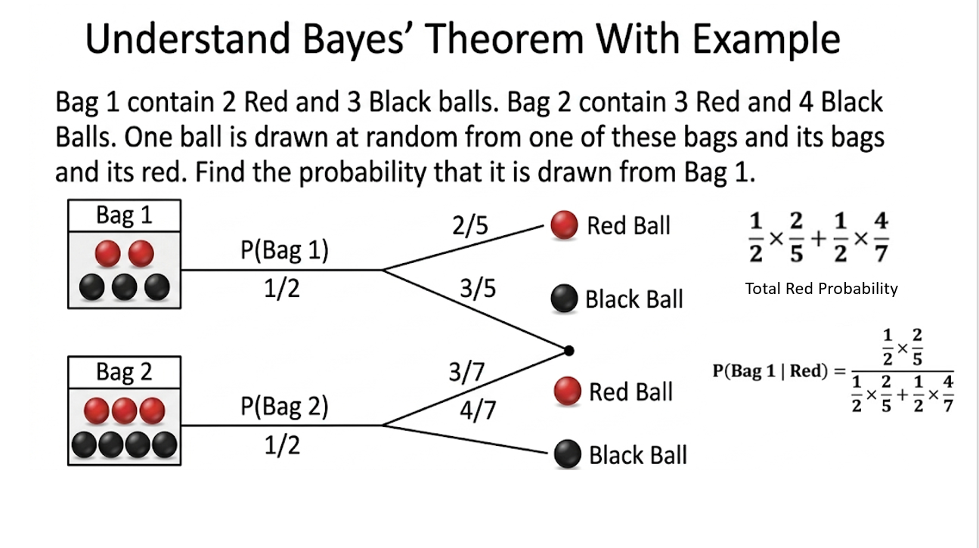

Slide 3
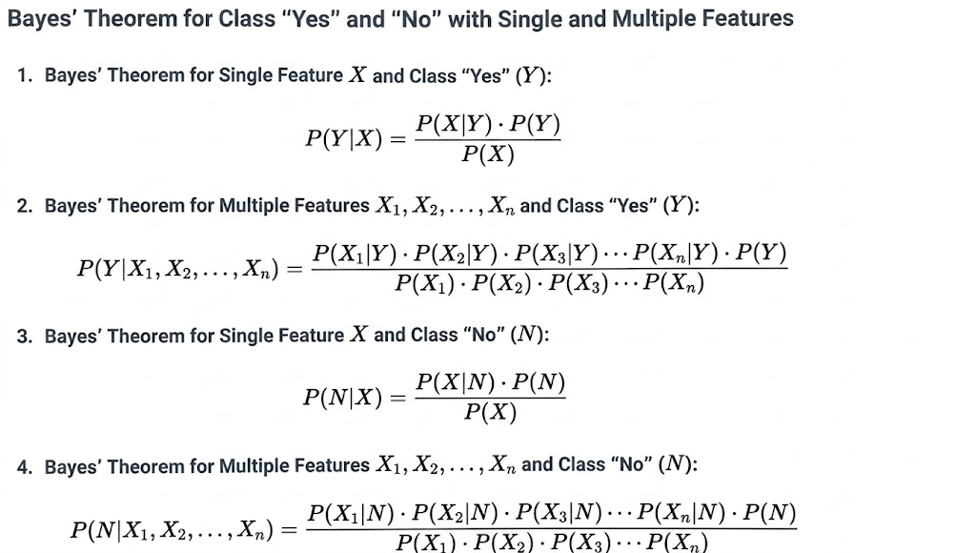

Slide 4
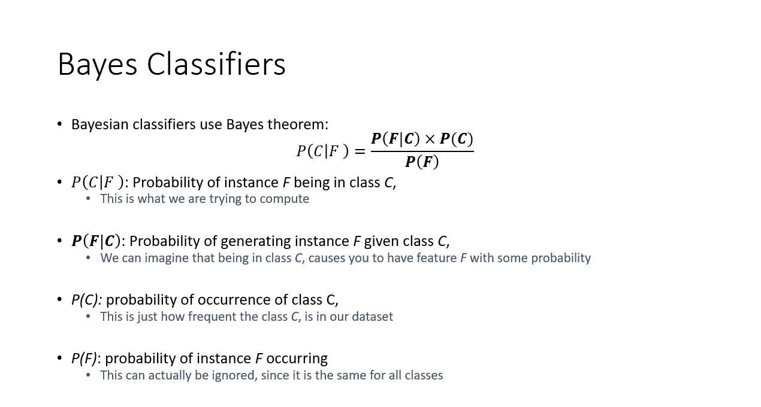

Slide 5
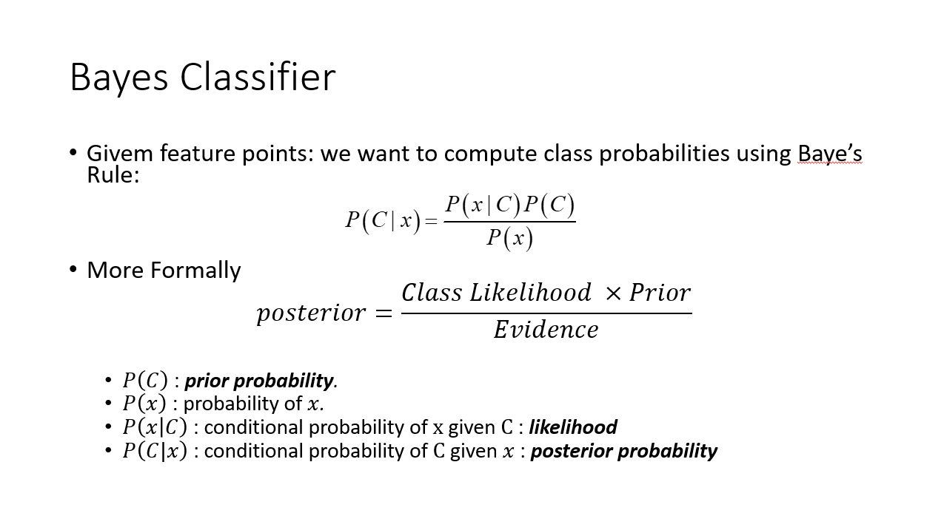

Slide 6
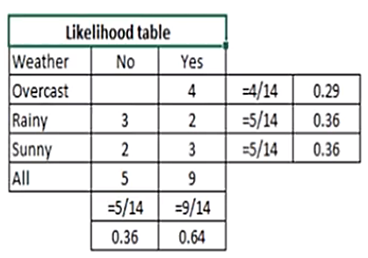
Example
Weather | Play
Sunny | No
Overcast | Yes
Rainy | Yes
Sunny | Yes
Sunny | Yes
Overcast | Yes
Rainy | No
Rainy | No
Sunny | Yes
Rainy | Yes
Sunny | No
Overcast | Yes
Overcast | Yes
Rainy | No
Problem:
Player will play or not if the weather is sunny?

Slide 7
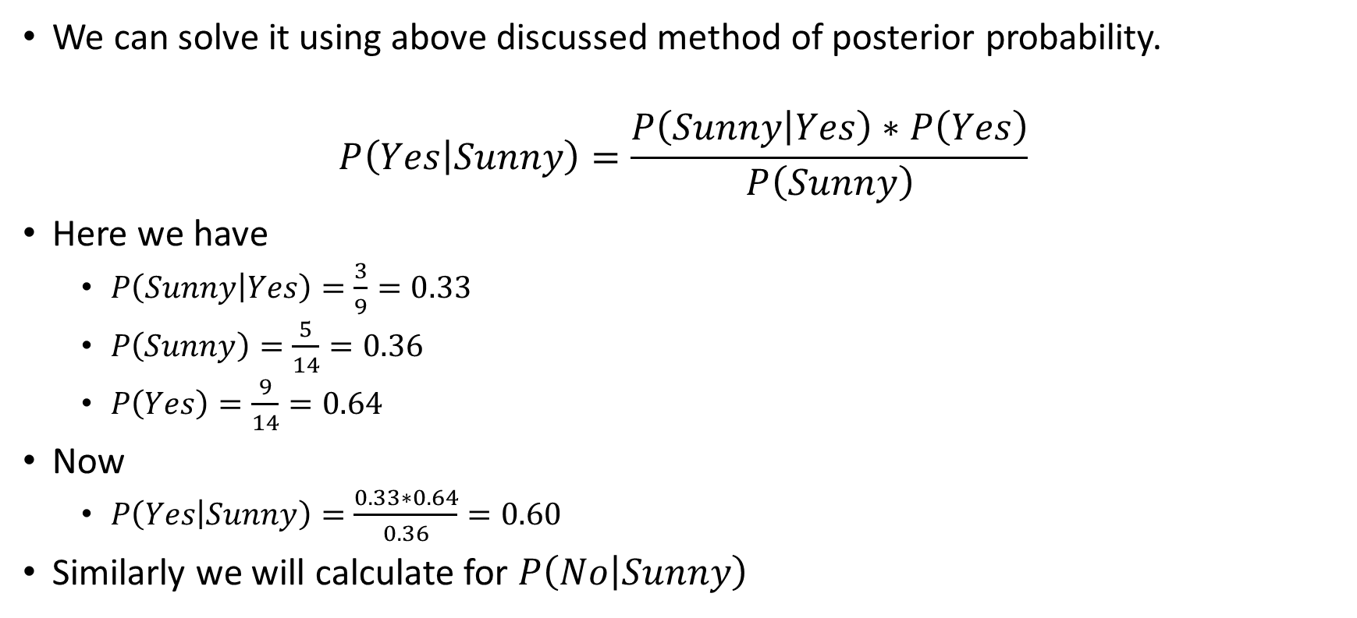
Example
We can solve it using above discussed method of posterior probability.
$$P\left(Yes | Sunny\right)=\frac{P\left(Sunny | Yes\right)∗P\left(Yes\right)}{P\left(Sunny\right)}$$
Here we have
$P\left(Sunny | Yes\right)=\frac{3}{9}=0.33$
$P\left(Sunny\right)=\frac{5}{14}=0.36$
$P\left(Yes\right)=\frac{9}{14}=0.64$
Now
$P\left(Yes | Sunny\right)=\frac{0.33∗0.64}{0.36}=0.60$
Similarly we will calculate for $P\left(No | Sunny\right)$

Slide 8
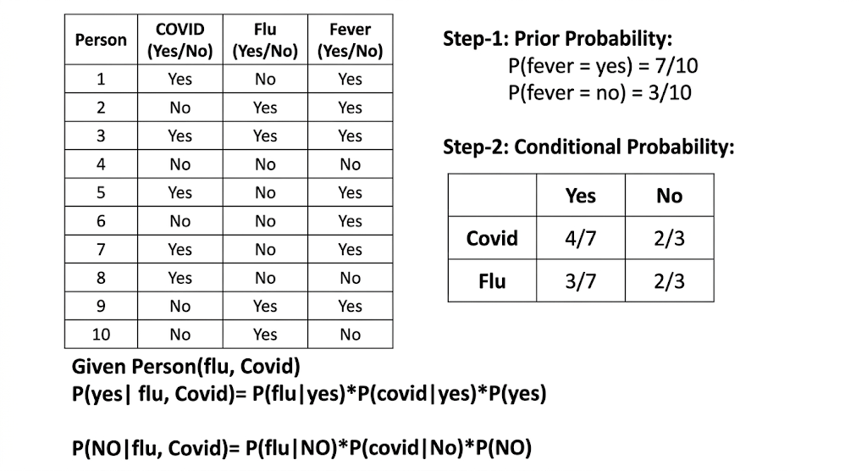
Example

Slide 9
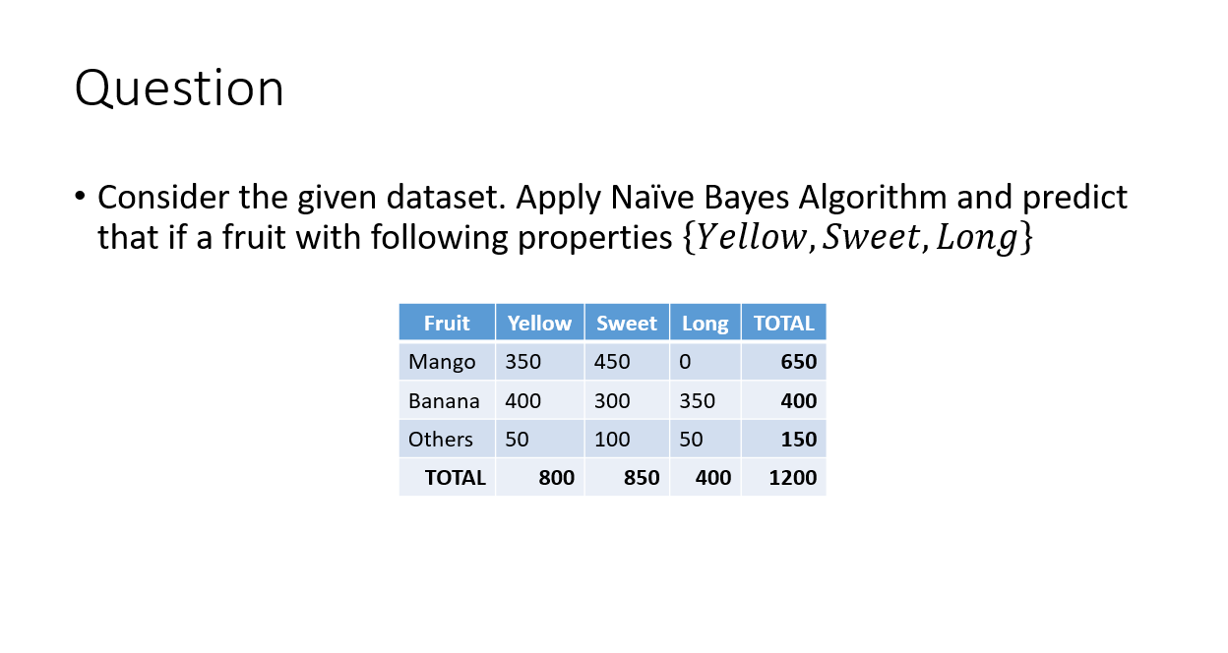

Slide 10

Question
For the given dataset, apply naïve Bayes algorithm to compute the prediction for a car with attributes
$\left\{Red, Domestic, SUV\right\}$
Color | Type | Origin | Stolen
Red | Sports | Domestic | Yes
Red | Sports | Domestic | No
Red | Sports | Domestic | Yes
Yellow | Sports | Domestic | No
Yellow | Sports | Imported | Yes
Yellow | SUV | Imported | No
Yellow | SUV | Imported | Yes
Yellow | SUV | Domestic | No
Red | SUV | Imported | No
Red | Sports | Imported | Yes

